Slide 1
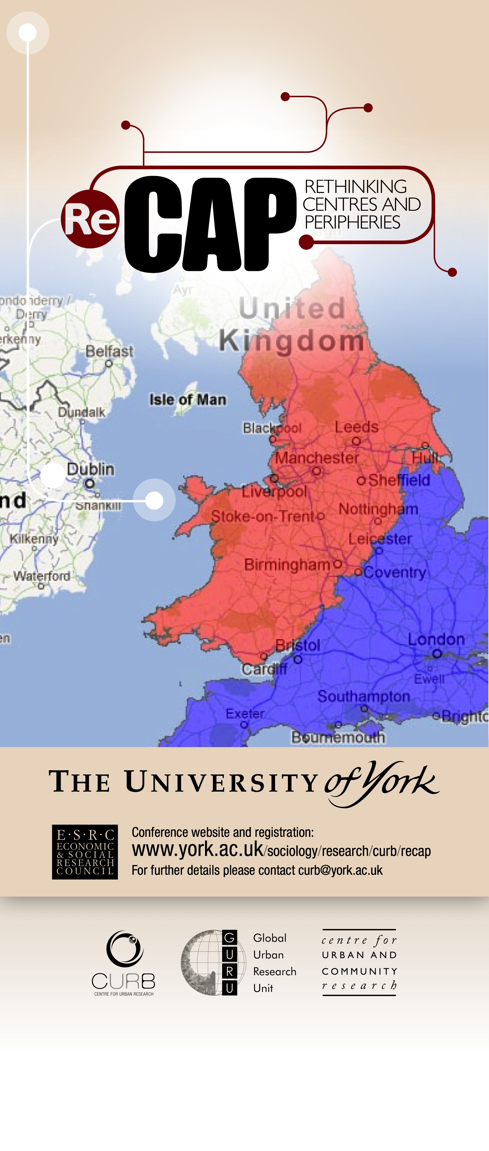
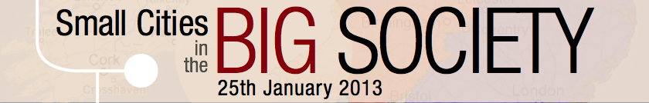


Rebalancing for what? Rebalancing for whom? The uneven geographies of urban policy in post-crash Britain
Simon Parker

Slide 2
Rebalancing: the Coalition view
We both want to build a new economy from the rubble of the old. We will support sustainable growth and enterprise, balanced across all regions and all industries.
David Cameron and Nick Clegg, in the Coalition agreement, May 2010

Slide 3
Rebalancing: the Coalition view
“What we need to do in this country is a massive rebalancing of our economy. We have been too reliant on government spending, on housing and finance... We have got to be more reliant on manufacturing and investment…Local Enterprise Partnerships would play an absolutely key role in bringing that rebalancing.”
“What is happening in Britain is a rebalancing of our economy. We need more private sector growth, we need a smaller public sector, we need to make more, sell more overseas and manufacture more. It's a slow and difficult healing process, but it is taking place.”
– David Cameron, 7 Mar 2011 and 9 Oct 2012

Slide 4
Rebalancing: the Coalition view
“What we need to do in this country is a massive rebalancing of our economy. We have been too reliant on government spending, on housing and finance... We have got to be more reliant on manufacturing and investment…Local Enterprise Partnerships would play an absolutely key role in bringing that rebalancing.”
“What is happening in Britain is a rebalancing of our economy. We need more private sector growth, we need a smaller public sector, we need to make more, sell more overseas and manufacture more. It's a slow and difficult healing process, but it is taking place.”
– David Cameron, 7 Mar 2011 and 9 Oct 2012

Slide 5
We need growth that lasts – rebalancing our economy, making the most of all our businesses and our industries, and turning a page on the overreliance on wheeling and dealing in the City of London.
I hope we can lift our sights beyond the immediate challenges, beyond the fiscal crisis, to the bigger question: how do we rebuild our economy, our country, to make our cities the powerhouses we all need you to be?
Nick Clegg, Sheffield, 14 January 2011

Slide 6
The policy measures
A £1bn regional growth fund specifically targeted at areas described as “overly reliant on the public sector”.
Plans to encourage increased bank lending.
Replacing regional development agencies with local enterprise partnerships aimed at growth "from the bottom up" to create jobs.
National insurance tax breaks for companies that start up in areas “overly reliant on the public sector”.
Localism Act powers to give town halls more freedom over the way they spend money.

Slide 7
Is there a North/South divide?
The Coalition states that the North/South divide is an oversimplification. It is true that there are inequalities within as well as between regions. Not all affluent places are in the South, nor all poor places in the North. But the evidence in this report shows that there remains a deep, long-term, continuing divergence between the North (the three Northern English regions – the North East, the North West, and Yorkshire & Humber) and the Greater South East (the East of England, London, and the South East).
…while previous regional polices for the North had mixed results in terms of narrowing the regional divide, the evidence taken from the Inquiry suggests that government doing less will likely make the position worse.
- Michael Ward, Smith Institute 2011

Slide 8
Uneven geographies of resilience
Only 2 of the top 50 most resilient local authorities are north of the Severn-Humber divide (Harrogate and Craven)
Only 7 of the bottom 50 resilient authorities are south of the Severn-Humber divide.
The near monopoly of the most highly educated workforce by London is as true for the most deprived boroughs as the least deprived.

Slide 9
London has 14 of the top 30 ranked local authorities for NVQ4+ (degree equivalent qualifications) including all of the top seven authorities in the country.
Hackney, Lambeth, Southwark, Haringey & Islington contain some of the highest concentrations of graduates in the country as well as some of the most deprived wards. This is not replicated in any other large English metropolitan region.

Slide 10
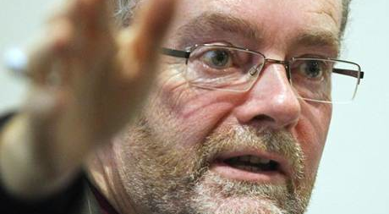
Urban diabetes?
“Urban diabetes is where the blood pumps around the heart but fails to reach all parts of the body. The challenge we face is to ensure that the wealth that we do have is shared in such a way that it flows around the whole body to every extremity. If in social terms it fails to do so then we will be faced with the danger of parts of the body atrophying and dying”
- Right Revd James Jones, Bishop of Liverpool

Slide 11
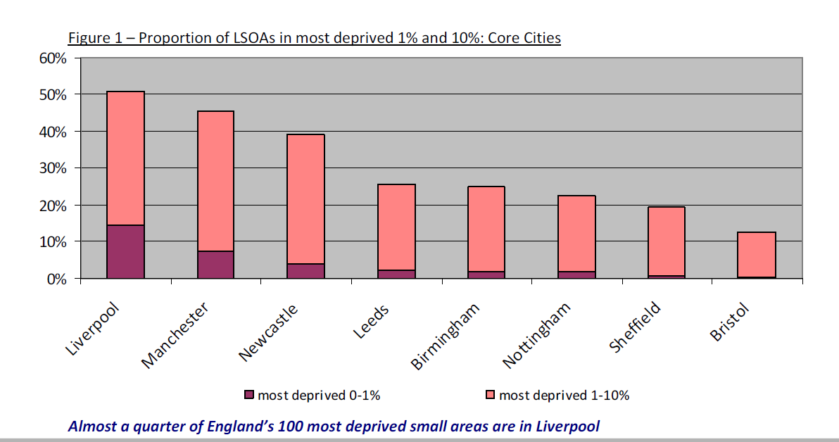
Liverpool = top-ranked English city, deprivation (2010)
Notes:
The Index of Multiple Deprivation 2010
A Liverpool analysis,

Slide 12
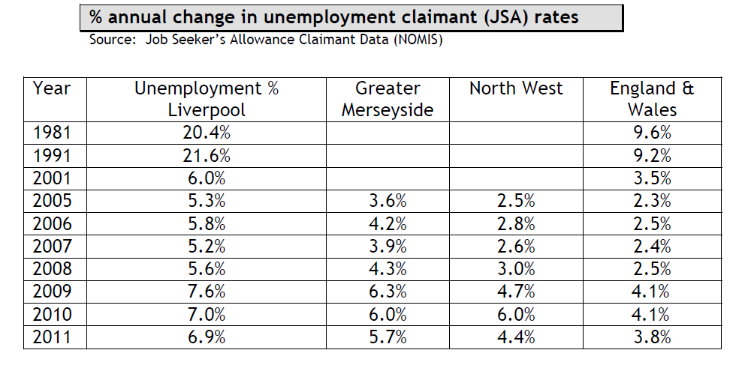
Unemployment twice national average

Slide 13
Is the public sector bleeding to death?
Public employment by sector (‘000s) 1999-2012
ONS 2012
Notes:
253,000 local government jobs went in the first half of 2012 and 154,000 central government jobs. A far higher and disproportionate loss of LA jobs which hit the three poorest regions hardest due to the lack of alternative employment.

Slide 14
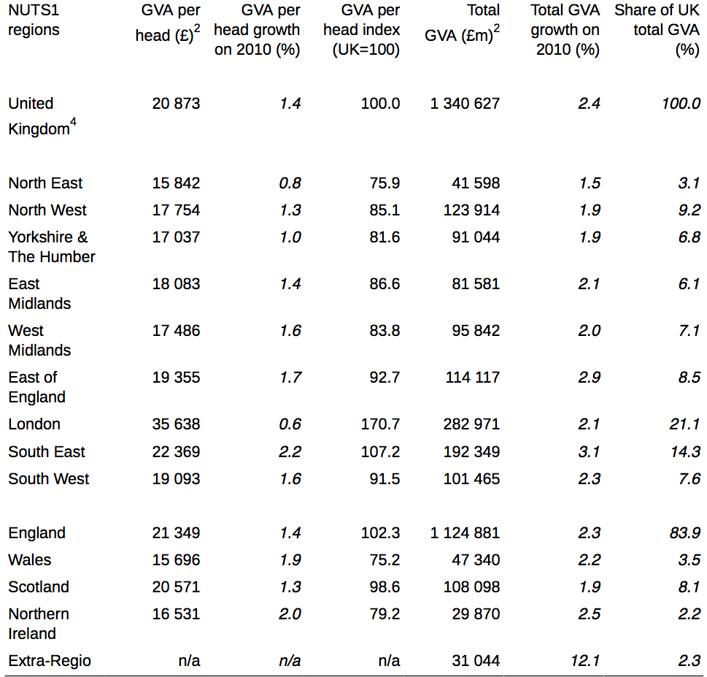
Londoners per capita have 3x the GVA of those in the north-east…one fifth of total UK GVA
ONS,2012

Slide 15
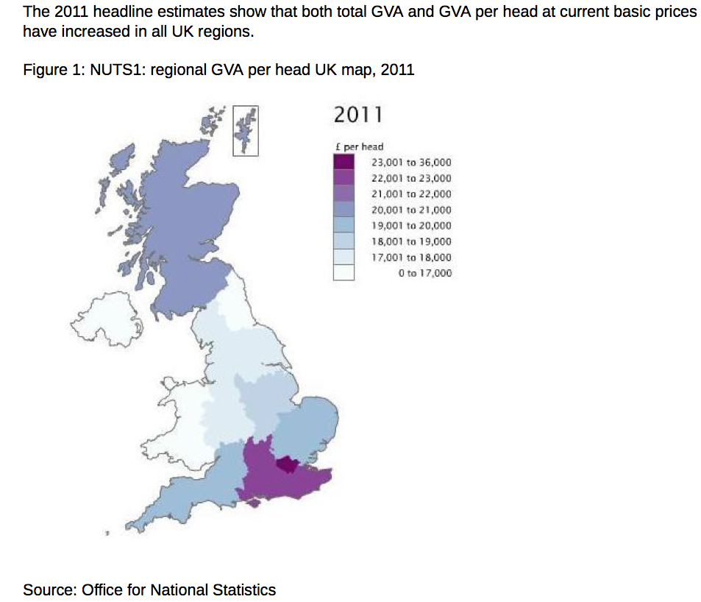
Source: D. Dorling

Slide 16
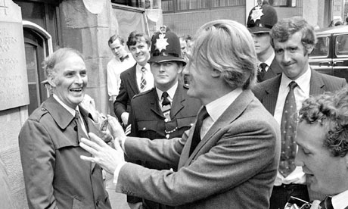
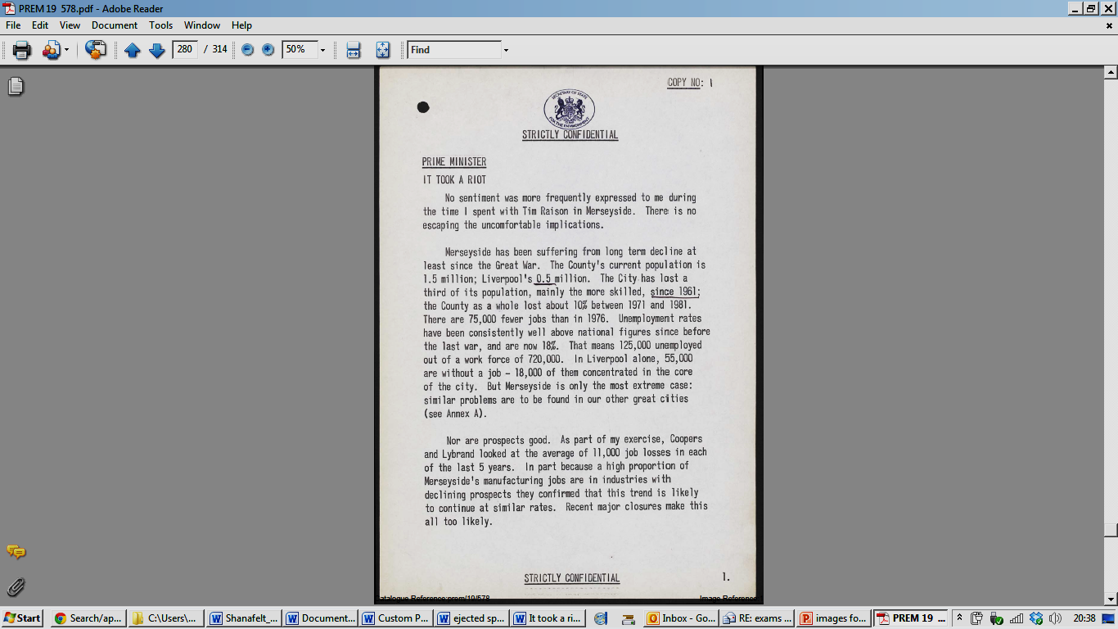
Or a persistent story of managed decline?

Slide 17
A picture of increasing wealth and regional inequality
The South East has biggest share of the wealthiest households
In 2008/10 the Wealth and Assets Survey (WAS) found combined net wealth of all private households within Great Britain =£10.3 trillion.
The wealth held by the richest 10% of households combined was £4.5 trillion and represented a 43.8% share of aggregate total wealth.
In contrast, the combined wealth of the bottom half of households in the distribution was £1.0 trillion; a value which accounted for 9.9% of aggregate total wealth.
The wealth held by the top 10% of households = 4 times greater than the wealth of the bottom half of all households combined and, over 850 times greater than that of the least wealthy 10% of households.
Source: ONS, Dec 2012.

Slide 18
The Components of Wealth
Private pensions account for over half of the total wealth held by those households in the top decile (56.6%). The median value of private pension wealth for these households was £742,000.
Private pension wealth contributed only 30.4% to the wealth held by the least wealthy half of households.
More than two out of five households (43.3%) in the least wealthy half of the distribution had no private pension wealth at all and the median value of private pension wealth held by this group was £4,000.
The contribution of property wealth (net) to the combined total wealth of the top 10% of households was 25.9% with a median value of £340,000. Property wealth made the largest contribution to total wealth for the least wealthy half of households (36.6%) even though only 41.4% of households in this group had any value of property wealth.

Slide 19
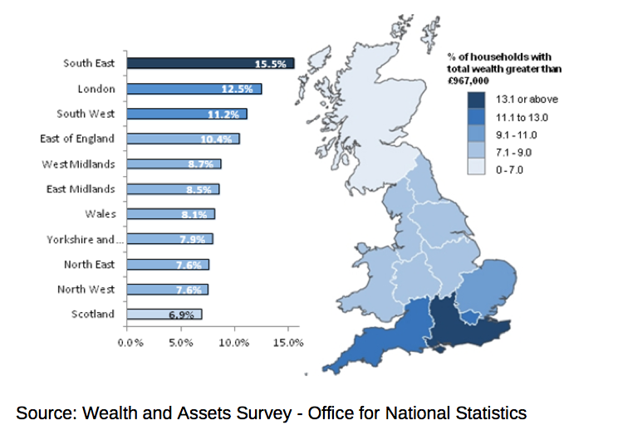
Percentage of Households with Total Wealth Greater than £967,000 by Region, Great Britain, 2008/10

Slide 20
Breadline Britain
14.0 million people (22.7%) UK population at risk of poverty or social exclusion (EU average of 24.1%) in 2011.
16.2% of UK were at risk of poverty in 2011, down from 18.7% in 2008 (mostly due to falls in median income leading to a reduction in the poverty threshold).
5.1% of people in the UK experiencing severe material deprivation, (EU average of 8.8%) in 2011. Broadly unchanged since 2005 when comparable figures were first produced.

Slide 21
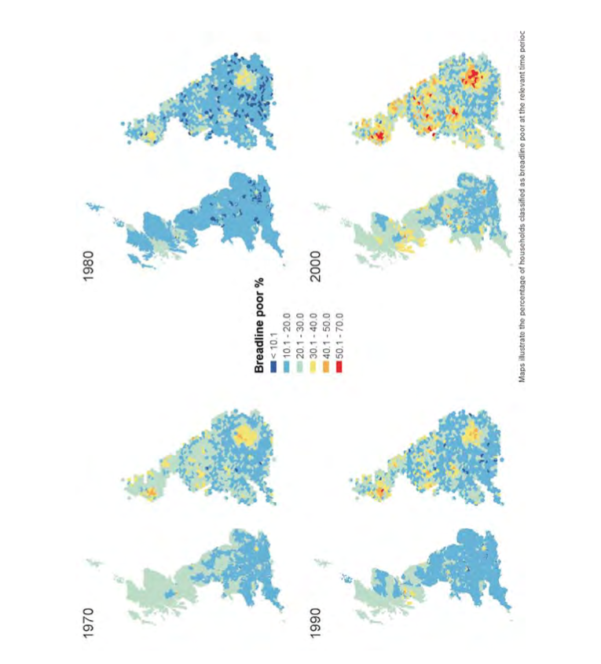
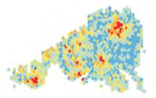
Non-metro towns less prone to acute poverty
“…there are now areas in some of our cities where over half of all households are breadline poor”
- Dorling, Rigby et al 2007
Notes:
Poverty, wealth and place in Britain, 1968 to 2005, Daniel Dorling, Jan Rigby, Ben Wheeler, Dimitris Ballas, Bethan Thomas, Eldin Fahmy, David Gordon and Ruth Lupton, JRF, 2007.

Slide 22
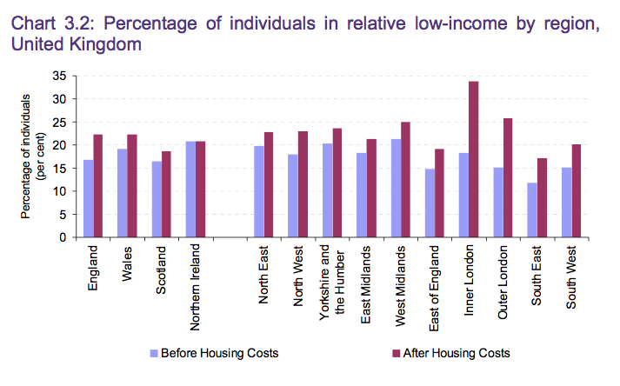
Source:DWP

Slide 23
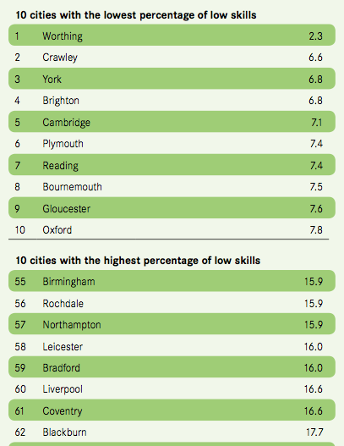
The Goldilocks Syndrome
York only city outside the south to have least lowest skilled work force
Cities with lowest skills are bigger, northern and diverse…

Slide 24
Cities with lowest and highest levels of inequality…

Slide 25
“Smaller cities feature significantly in both the top 10 and the bottom 10 lists. Seven of the top 10 cities with the highest ratios of private to public sector employment are small. And five of the smallest cities (Gloucester, Worthing, Hastings, Cambridge and Dundee) are also amongst the cities with the greatest dependence on the public sector”.
Leeds = only major city to appear in the top 10, with three jobs in the private sector to every job in the public sector.
Liverpool = the only major city in the bottom 10, with only 1.9 private sector jobs to every job in the public sector.

Slide 26
Conclusion
Smaller cities appear to be more resilient than larger cities
Larger northern cities are the least resilient but some in the north are doing OK
The north/south divide needs qualifying in the light of significant variations to the resilience trend, especially among smaller cities.

